Slide 1
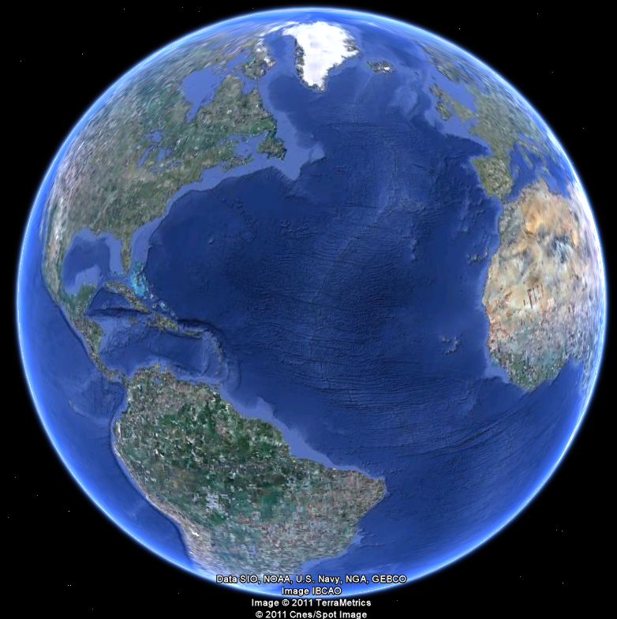
APEC 100 Sustainable Development
Valuing Ecosystem Services

Slide 2
Alternative Terms for “Ecosystem Services”
US public’s comfort to terms connected to “Ecosystem Services”: prefer to call this framework something other than “ecosystem services”
Reaction to Alternative Phrases to Describe Ecosystem Services
Preference | Name | % Rating a 6 or 7 (Very Appealing) | Mean Score
The most preferred 4 terms | Nature’s Value | 61% | 5.5
 | Nature’s Benefits | 53% | 5.3
 | Earth’s Benefits | 55% | 5.2
 | Environmental Value | 49% | 5.2
The least preferred 4terms | Ecosystem Services | 31% | 4.5
 | Nature’s Social Safety Net | 34% | 4.4
 | Natural Capital | 30% | 4.3
 | Earth’s Capital | 29% | 4.2
(Source: Key Findings From Recent National Opinion Research on “Ecosystem Services”)

Slide 3
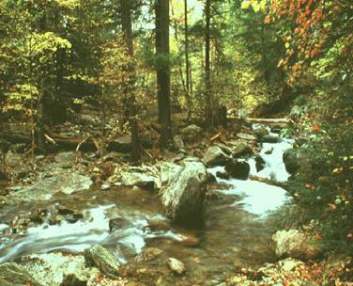
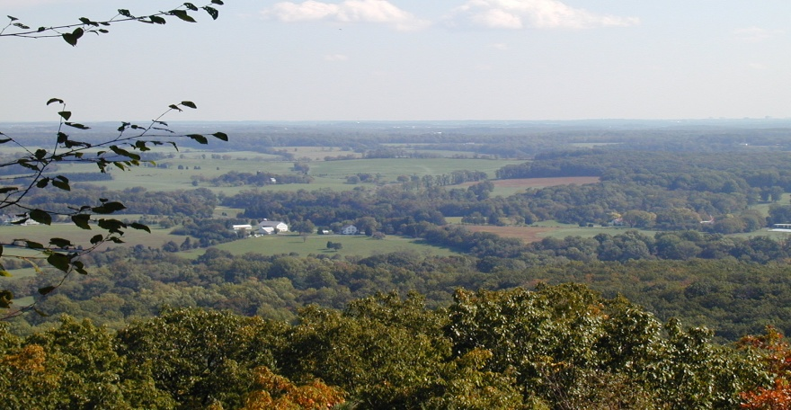
Economic Benefits of Protecting Natural Systems and Green Infrastructure
Economics as a humanistic philosophical perspective
“Use Value”
Ecosystem Services
Wetlands & water filtration
Trees, forests, and air cleaning
Working lands
Tourism
Recreation
Real estate
“Future Use Value”
Option to use later
“Non-use Value”
Existence and intrinsic values

Slide 4
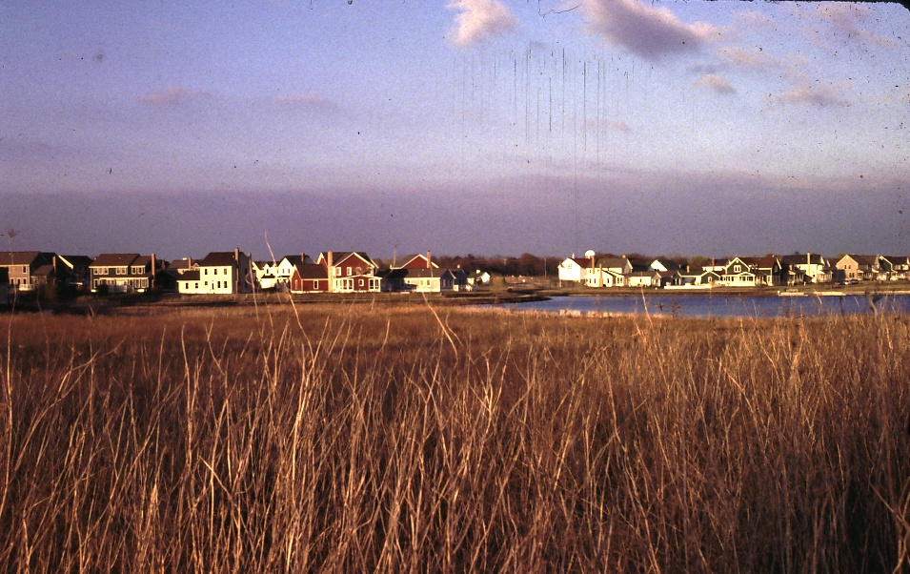
Values for the Protection of Green Infrastructure
Values typically increases with several factors:
Income of residents
Education
Number of people “consuming” the good

Slide 5
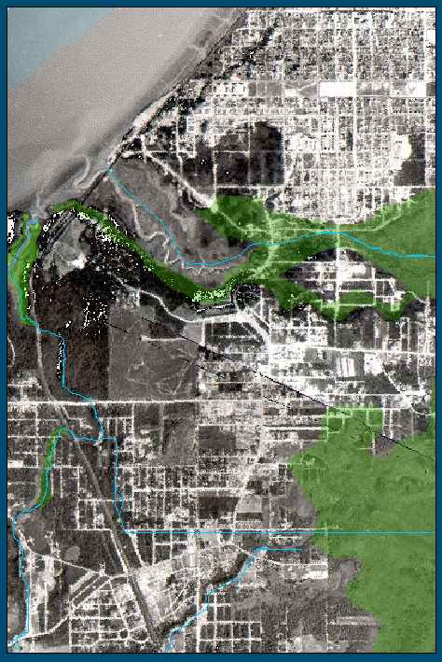
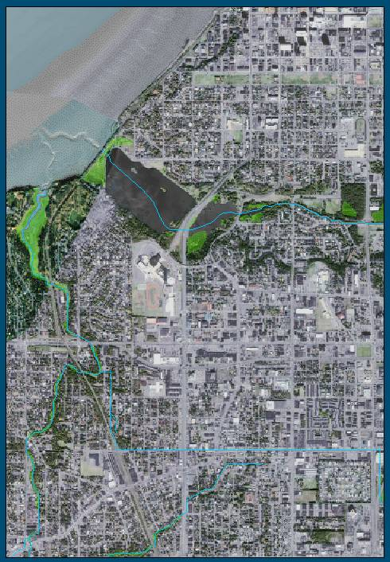
Value Grows with Scarcity
You don’t know what you’ve got…
… until it’s gone!
Anchorage, approx. 1960
Anchorage, approx. 2000

Slide 6
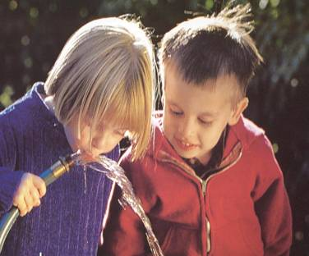
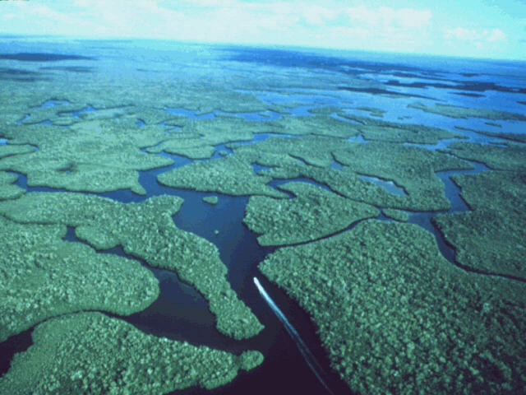
Ecosystem Services: Wetlands
New York City
Deliver 1.3 billion g/day.
New water treatment plant ($6-8 billion) versus $1-1.5 billion over 10 years to protect Catskill, Delaware & Croton watersheds
Charles River Basin, Massachusetts
8,534 acres of freshwater marsh & wooded swamp
More than $95 million in annual economic benefits including:
$40 million in flood damage prevention
$25 million in pollution reduction
Maryland
Since 1973, tree loss resulted in 19% increase in storm water runoff (540 M ft²) with a cost of over $1 billion to manage.
National Studies: Land preservation for flood storage has an estimated 8:1 dollar savings over man-made flood control structures
(Source: The Economic Benefits of Protecting Green Infrastructure)

Slide 7
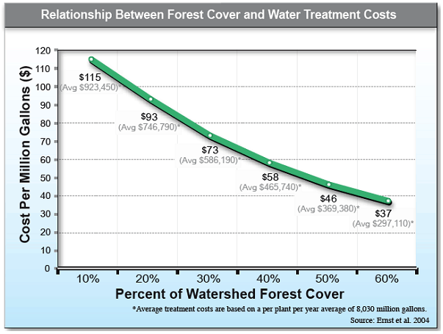
Notes:
Change title to reflect Drinking water treatment

Slide 8
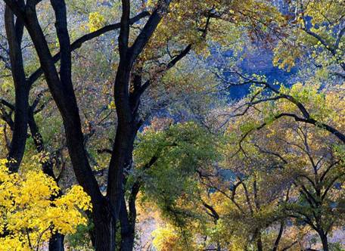
Ecosystems Services - Trees & Forests
American Forestry Association
One 50-year-old urban tree saves
$75/yr in air conditioning
$75/yr in storm water & soil erosion control
$75/yr in wildlife shelter
$50/yr in air pollution control
Which of these estimates are easiest to measure accurately?
Delaware Valley
Urban forests remove 1.7 million pounds of air pollutants each year
Value ~$3.9 million
Notes:
Trees and forests also provide a tremendous amount of free natural services -

Slide 9
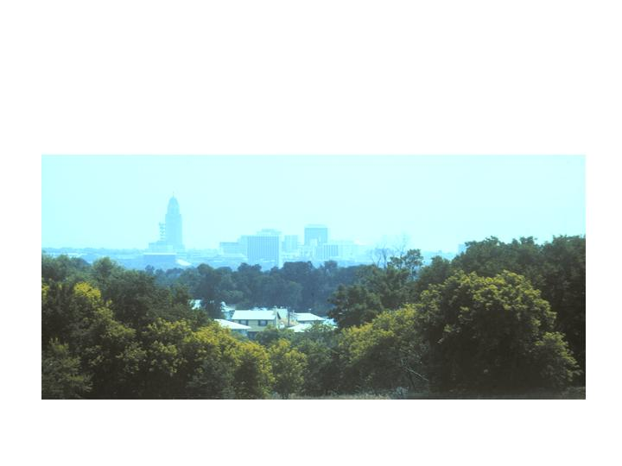
Ecosystems Services - Trees & Forests
Sacramento
Urban forests remove > 200,000 metric tons/yr.
Value ~$3 million/year in pollution cleanup costs
New York City
More than 5 million trees cover 17% of public & private land
Value ~$10 million/year in pollution mitigation costs
Notes:
Open spaces bring about economic benefits simply by allowing nature to do what it does best. It is far less expensive to let Mother Nature’s systems keep water and air clean rather than trying to craft a technological, gray infrastructure solution.
For example, the 8,534 acres of freshwater marsh and wooded swamp in the Charles River Basin (Boston, MA) provide more than $95 million in economic benefits annually, including $40 million in flood damage prevention and $25 million in pollution reduction, as well as $31 million in recreation value from hunting and fishing

Slide 10
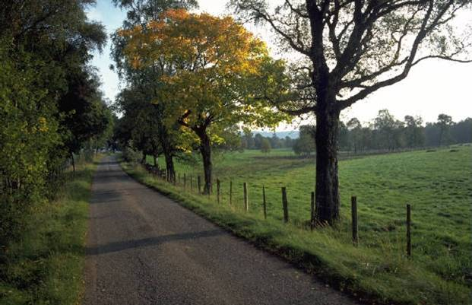
Working Farms and Forests
Working Lands
Major source of resource goods and jobs
Economic engine for rural regions and
major contributor to state economies
Link to rural character and quality of life
Virginia
Forestry – 228,000 jobs
~$10 billion
Agriculture – 235,000 jobs
~$20 billion
Notes:
In addition to providing habitat for wildlife and “space” for ecological processes to function, sustainably managed working lands can also be a major source of goods and jobs, and contribute significantly to rural and state economies.
For example, 1997 data from Virginia ----

Slide 11
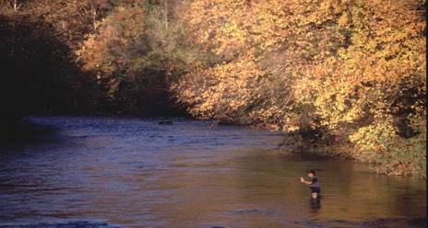
Nature-Based Tourism and Recreation
Recreation (hunting, fishing, wildlife watching)
2001 ~$108 billion
2006 ~$120 billion
West Virginia
Hunting 6,246 jobs, $398 million
Fishing 4,450 jobs, $309 million
Wildlife watching 3,466 jobs, $190 million
TOTAL nearly $900 million
Cape May County, New Jersey
$34 million/year due to shorebird “birding” revenue
Notes:
Natural systems doing what they do best is also crucial for nature-based tourism, a significant form of recreation and a major contributor to economies nationwide and by state and region.
Go over data –
A recent AP news story talked about the decrease in hunting and fishing in different regions of the country. One of the reasons that were cited was the reduction in free time, but equally important was the loss of hunting and fishing lands close to home due to the consumption and fragmentation of open lands associated with metropolitan growth.

Slide 12
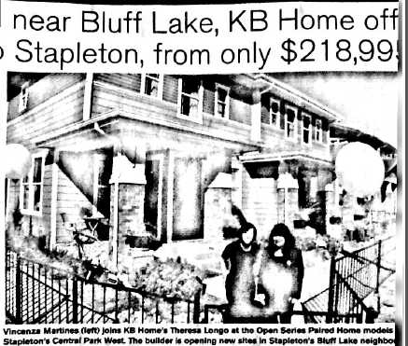
Real Estate
Open space helps sell homes & communities
1994 survey – 77% ranked “lots of natural green space”
2nd after “low traffic & quiet” (tennis 28th, golf 29th)
National Association of Realtors Survey – hiking & biking as top amenity to homebuyers not golf courses and pools
Notes:
1994 survey – tennis ranked 28th and golf 29th
NAR Survey # 1 - Hiking and biking top choice for recreational amenities
Who uses recreational facilities? 1-2% of respondents use golf courses, 5-6% use pools and 50-60% MORE THAN HALF use pathway systems.
And linked greenway and green infrastructure systems provide more bang for the buck and better access to more people!

Slide 13
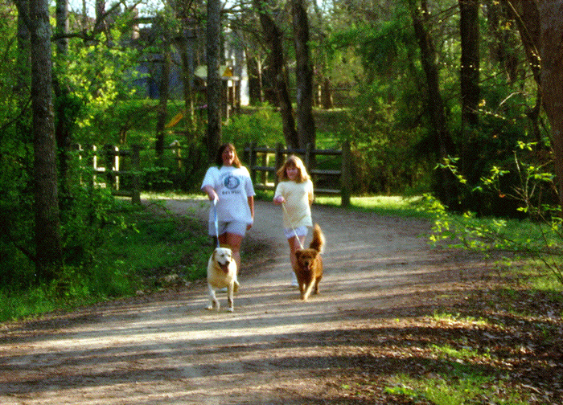
Property values
Homes near greenbelts sell for approximately 15-25% more than similar homes not near green infrastructure.
Estimated using the hedonic pricing method
Property values reflect only the direct use benefit of being closer to Green Infrastructure.
Thus, just part of the overall value for conservation.

Slide 14
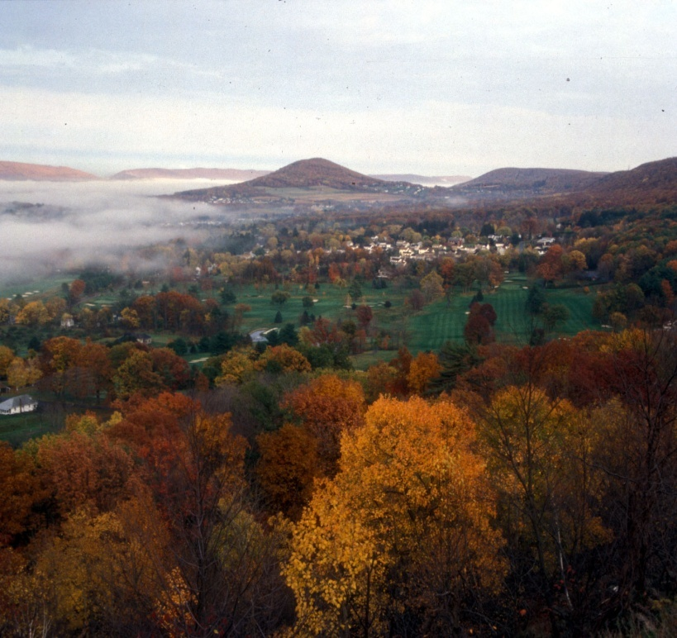
Real Estate
Oregon – land by greenbelt ~$1,200 more per acre than 1000 ft. away
California – 3-mile green belt added $41 million in value to surrounding properties
Alaska – 15% greater value for properties adjacent to Anchorage greenways
Canada - 12 -16% greater value for properties adjacent to greenways
Notes:
Salem, Oregon
Oakland, California
Four Urban Communities in Canada

Slide 15
Property values do reflect expected future benefits
Expected future benefits are “capitalized” into current property values.
If benefits are uncertain, current values will be lower.
Permanent protection creates certainty, and therefore, increased value.

Slide 16
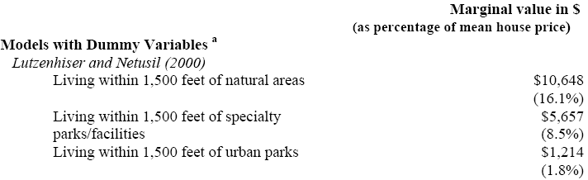
Proximity to “Natural Areas”
or
Proximity to “Specialty Parks and Facilities”
Source: McConnell-Walls 2005

Slide 17
Property values: Anchorage example
Suppose, there are 2,500 houses along Anchorage creeks & greenbelts.
Average home value = $300,000.
With a 15% price premium, the value of these creeks and greenbelts is more than $100 million.
(Source: Steve Colt, UAA)
15% x $300,000 = $45,000 per house.
2,500 houses x $45,000 = $112,500,000.
Note: everyone shares some of this value through increased tax revenue.

Slide 18
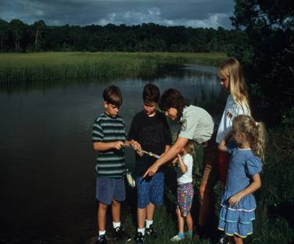
Green Infrastructure Attracts Residents
Residents trade off quality of life for other economic benefits.
Employers may be able to get higher-quality work force for lower salary.
Little systematic data on this effect.
But it is measurable, in principle.

Slide 19
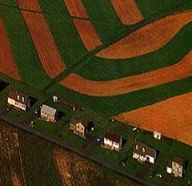
Cost of Community Services
Open space helps reduce costs of services, including:
√ Gray Infrastructure – Roads, Sewers, Water, Stormwater
√ Schools, Libraries
√ Fire and police protection, EMS
√ Trash Collection
√ Public Transportation
√ Recreation
√ Government
Notes:
Over 70 cost of community services studies have been undertaken nationwide. The results consistently show that for residential land, the cost of service ratios are greater than one while the ratios for commercial and industrial development are typically less than one.
This is slide presents another way to look at this -

Slide 20
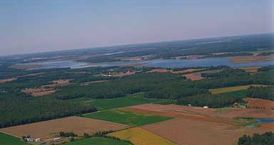
Cost of Community Services
Loudon County, Virginia (1999):
Each new house on a ¼ acre lot costs $705/yr in services.
Each new house on a 5 acre lot costs $2,232/yr.
(Source: www.sierraclub.org/sprawl/articles/meadows2.asp)
Bandera Co. Texas:
Ranch/open land: for every $1 of property tax generated, demand in services is $0.26
Residential land costs $1.10 in services for every $1.00 generated
(Source: Finding the balance: ranching and rapid growth in Bandera county, Texas)
Marshall Township, Michigan
- Farm and open space required: $0.27 in services
Commercial/industrial: $0.20 in services
Residential Land: $1.47 in services
(Source: Cost of Community Services <www.mqtinfo.org/planningeduc0087.asp/)

Slide 21
The High Cost of Restoration
 | Impairment | Miles | Cost | Avg. Cost/mile
Corsica River, MD | Nutrients | 7.6 | $17,500,000 | $2,300,000
Little Laurel Run, PA | Metals | 3 | $1,048,013 | $349,338
Conewago Ck, PA | Nutrients | 17 | $4,300,000 | $252,941
Bear Ck, PA | Metals | 5 | $964,000 | $192,800
Catawissa Ck, PA | Metals | 57.9 | $3,500,000 | $60,440
Thumb Run, VA | Bacteria | 17 | $2,450,000 | $144,117
Willis River, VA | Bacteria | 30 | $2,794,160 | $93,138
Muddy Creek, VA | Bacteria | 9 | $2,612,000 | $290,222
(Source: Watershed Management in Frederick County)
21

Slide 22
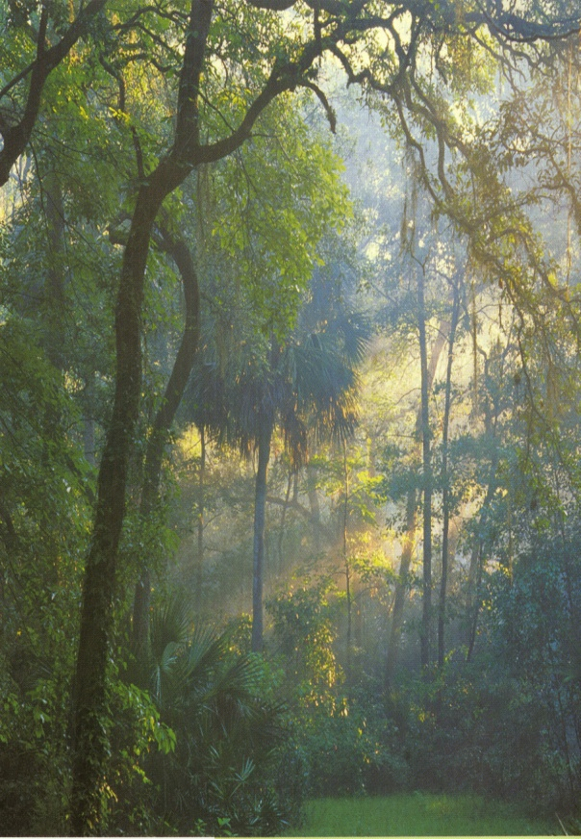
Quality of Life – Existence Value
People are willing to pay for the continued existence of natural environments they may never use
Bequest Values – gifts to next generation
Florida
Everglades – Floridians willing to pay $12 billion to protect system in perpetuity
(Source: Investing in Nature: The Economic Benefits of Conserving Natural Areas in Northeast Florida)
Notes:
This and other research shows that people are willing to pay for a better quality of life and for access to natural amenities.
FROM DOW NE FLORIDA ECONOMIC BENEFITS OF CONSERVING NATURAL AREAS STUDY
In addition to being willing to pay for natural benefits from which they draw a direct benefit, people also express a willingness to pay for the continued existence of natural environments they may never use or even see, but perceive as having value simply because they are there.
These places have what economists refer to as EXISTENCE VALUE.
Everglades data based on two 1999 surveys – for wetlands and wildlife:
Found the average Florida household would be willing to pay $70/yr (total of $400 million per year) for everglades wildlife and $59/year (total $340 million per year) to protect water resources

